Slide 1
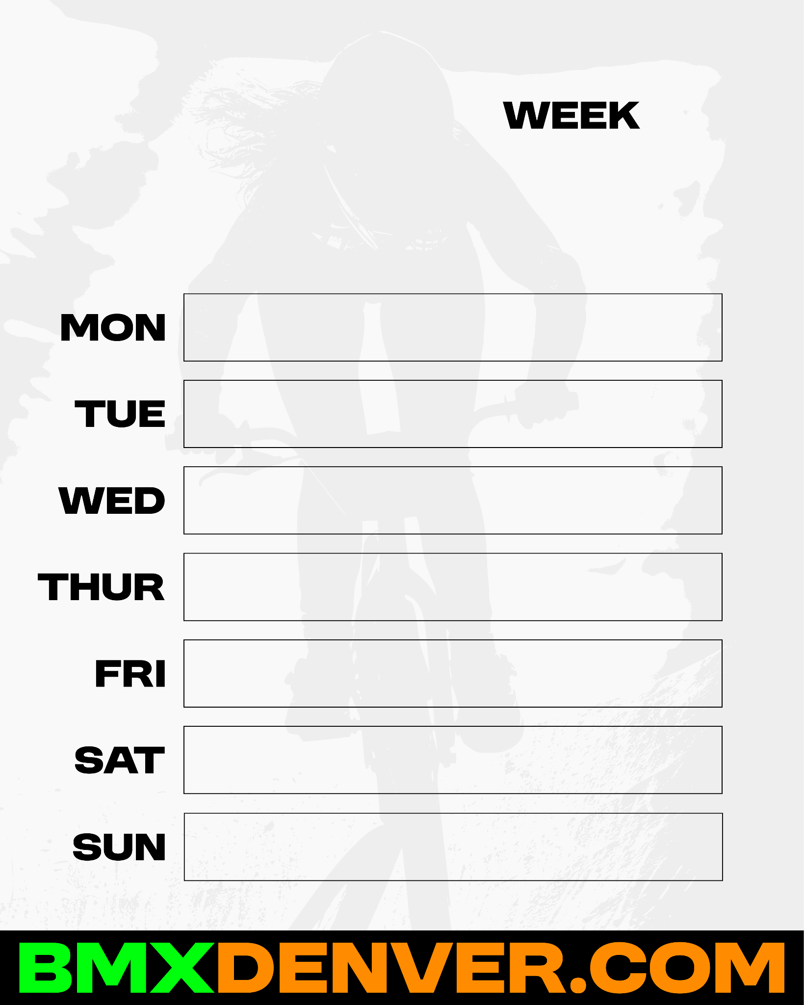

11/3-11/9
VOLUNTEER MAINTENANCE NIGHT!
Free pizza and riding after 530-630pm
6-8pm practice ($5 or D-pass)
No scheduled events
6-8pm practice & race ($10 or D-pass)
No scheduled events
VOLUNTEER MAINTENANCE NIGHT!
Free pizza and riding after
2-4pm practice & race ($15 or D-pass)

